Slide 1
Predicting Affordability of House in Ames, Iowa
Team JAIS
Yuqi Zhu, zhuyuki@g.ucla.edu
Jaehyeong Lee, ivcrkffody96@g.ucla.edu
Avash Monajemi, javacash@g.ucla.edu
Iris Liu, iris.liu@ucla.edu

Slide 2
Data cleaning
Remove variables with over 50% NAs
Change NAs into other levels
Merge variables in a new column
Modify variables

Slide 3
Drop variables
New variable
Merged variables
Fireplace | FireplaceQu | Fence | PoolQC | Condition2 | RoofMatl
PoolArea | MiscVal | LotArea | Street | Utilities | MasVnrArea
x2ndFlrSF | X1stFlrSF | Alley | YearBuilt | Exterior2nd | BsmtExposure
ExterCond | BsmtFinType1 | BsmtFinType2 | BsmtFinSF1 | BsmtFinSF2 | BsmtUnfSF
CentralAir | Electrical | KitchenAbvGr | Functional | GarageYrBlt | GarageCars
GarageQual | GarageCond | PavedDrive | BsmtFullBath | BsmtHalfBath | FullBath
HalfBath | EnclosedPorch

Slide 4
Processing NA’s
Put NA into most common pre-existing level
Create a new level for NA: “None” or “other”
Replace NA with variable average or 0 for non-existence
LotFront grouped by neighborhood

Slide 5
Merging Variables
New Variable | Old Variables
totalbsmtbath | BsmtFullBath + BsmHalfBath*0.5
totalbath | FullBath + HalfBath*0.5

Slide 6
Create New Y/N Variable
Variables | From numerical variable in the data
2ndFlr | 2ndFlrSF
fireplace | Fireplace
RemodAdd | YearRemodAdd
WoodDeck | WoodDeckSF
SsnPorch | X3SsnPorch
ScreenPorch | ScreenPorch
pool | PoolArea

Slide 7
Simplifying Factor Levels
Variable | Old Levels | New Levels
LotShape | IR1, IR2, IR3, Reg | IREG, Reg
Fence | GdPrv, GdWo, MnWw, “NA” | Yes, No

Slide 8
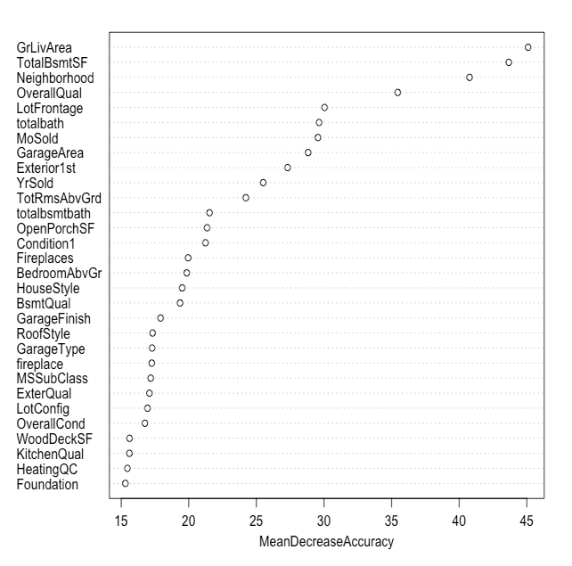
Variable importance
Our top 7 important variables :
GrLivArea
TotalBsmtSF
Neighborhood
OverallQual
LotFrontage
Totalbath
Mosold

Slide 9
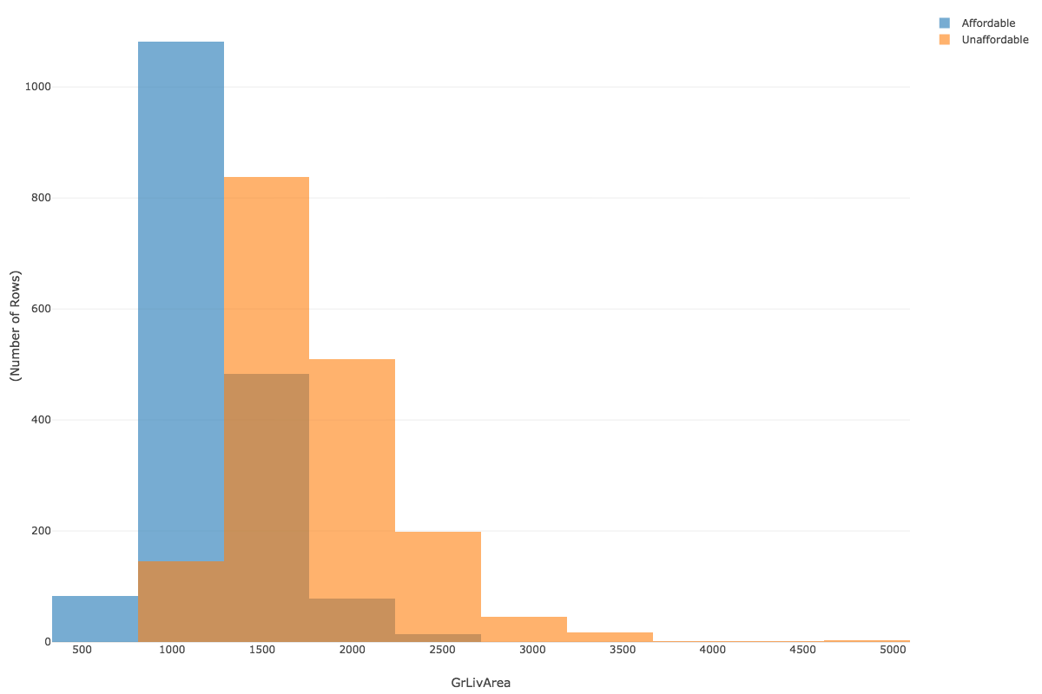
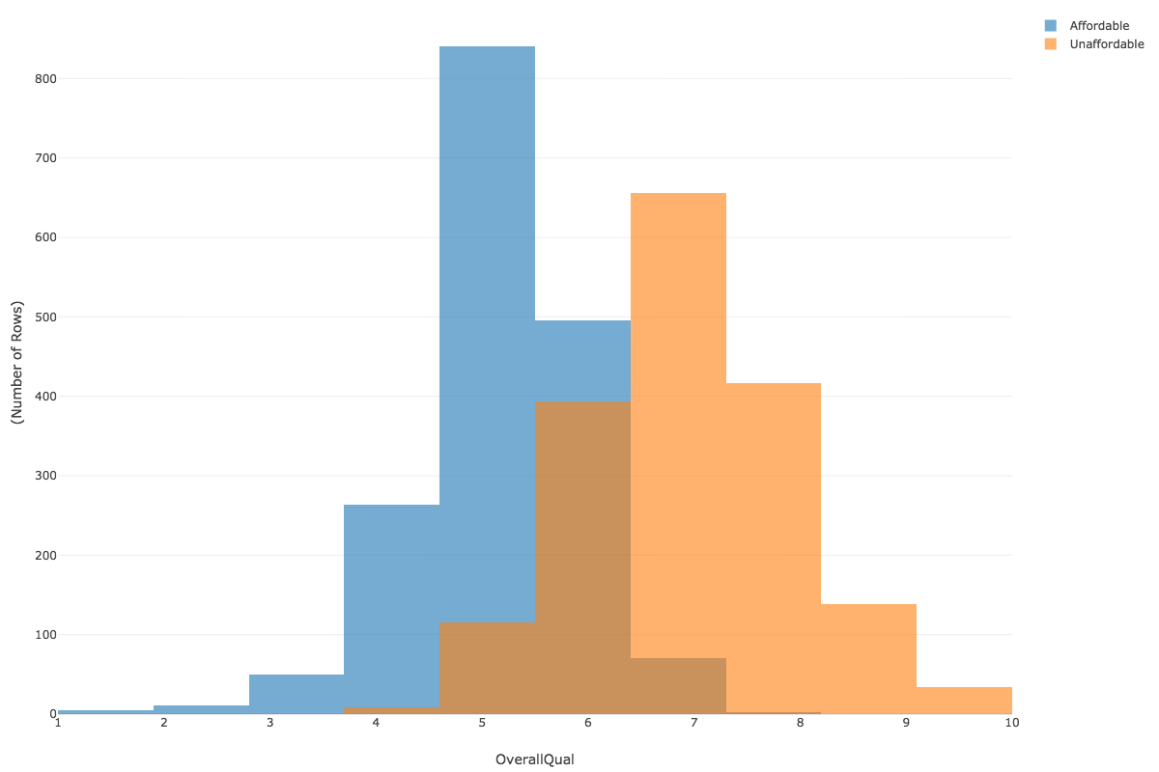
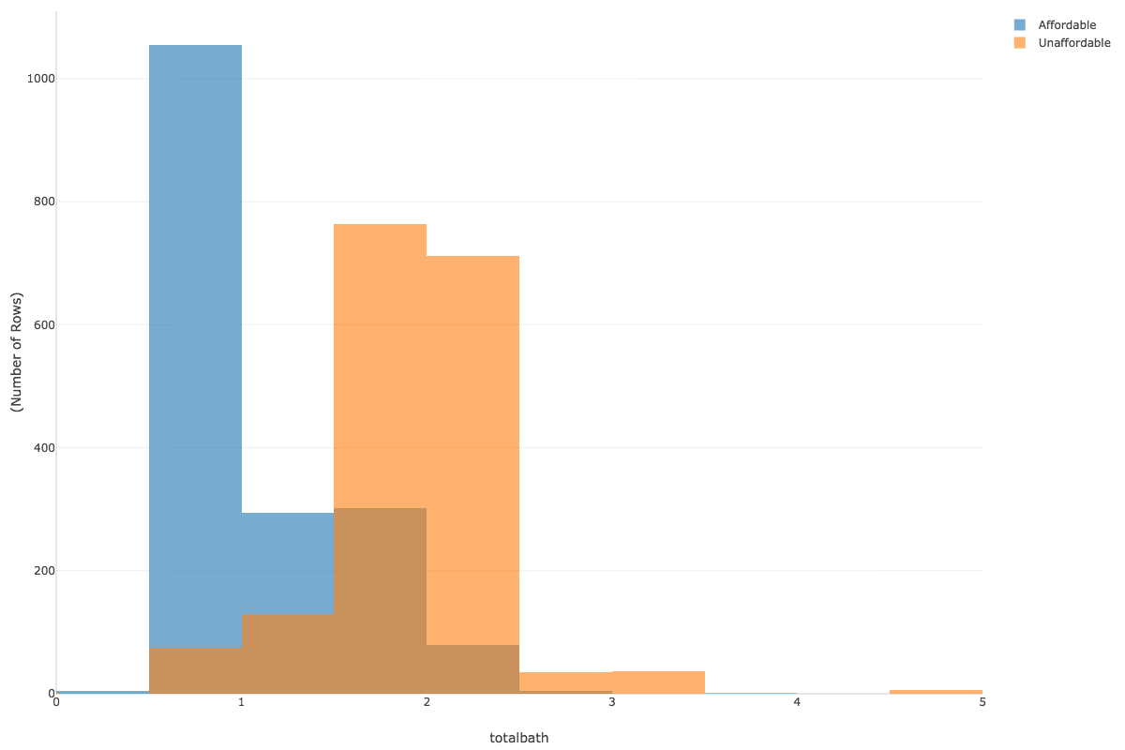
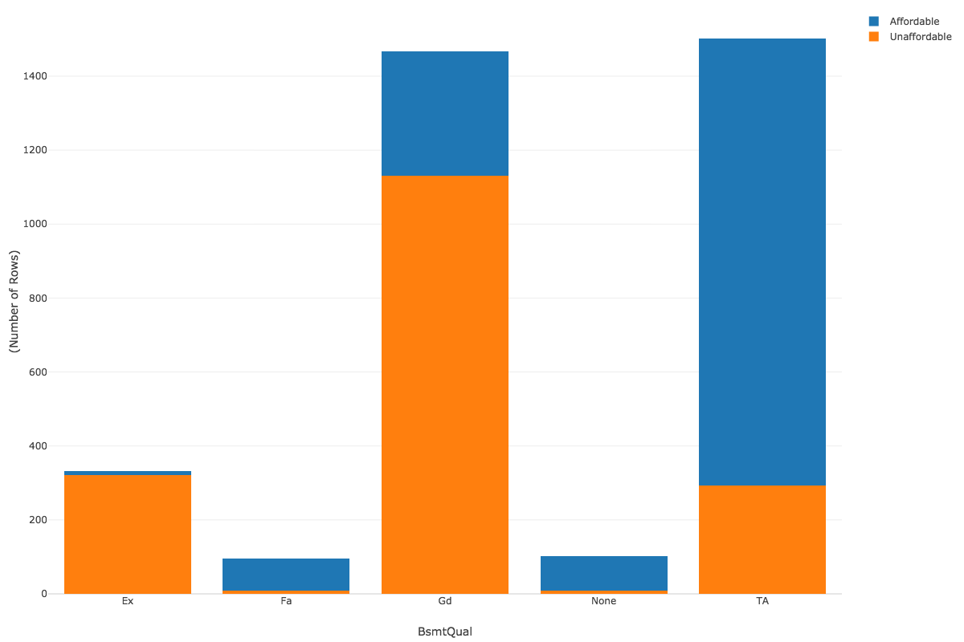
Overall quality
Ground Living Area
Total bathroom
Basement quality

Slide 10
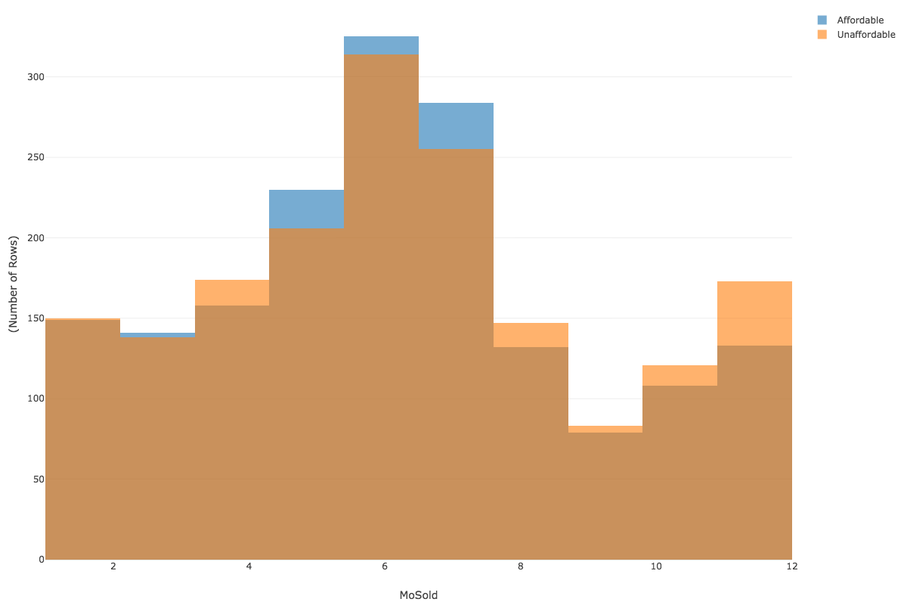
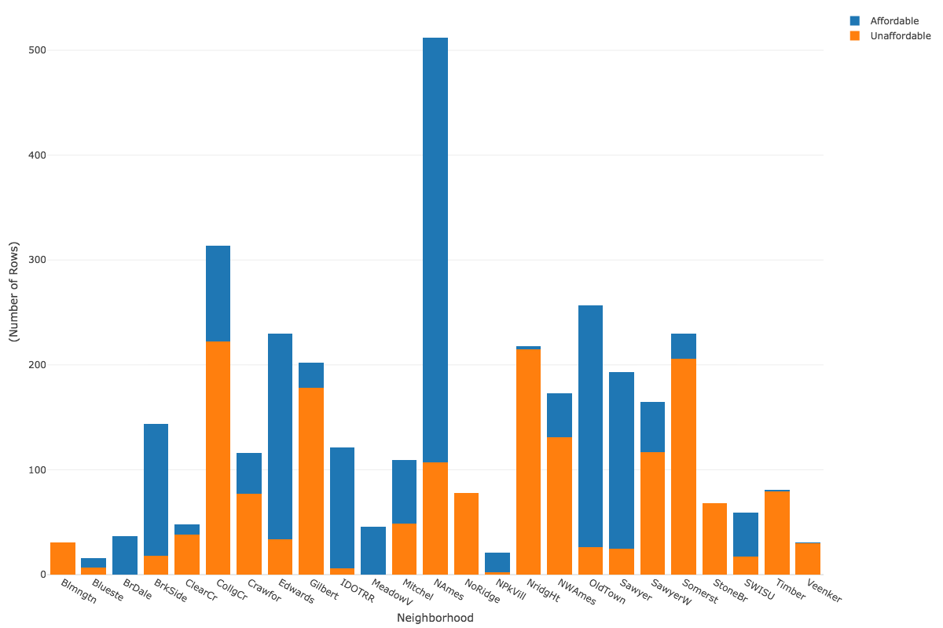
Neighborhood
Month Sold

Slide 11
Modelling

Slide 12
Random Forest
Random Forest performs well for both numerical and categorical features
High accuracy due to the combination of bootstrapped samples and random predictor draws
No issues with higher dimensionality data

Slide 13
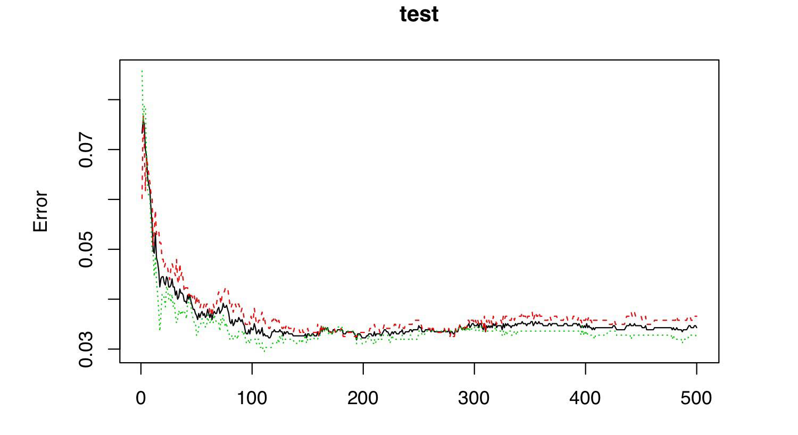
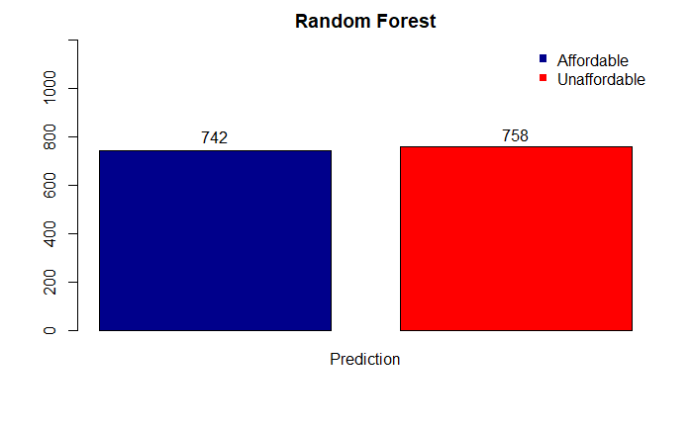
Random Forest
Quick to train the model
Divided the 70% of the training data into new training dataset and 30% into testing dataset
Used 8 as value for mtry parameter, number of variables sampled as candidates for each split
As dataset increases, error rates become stabilized to near 0.03

Slide 14
Other models

Slide 15
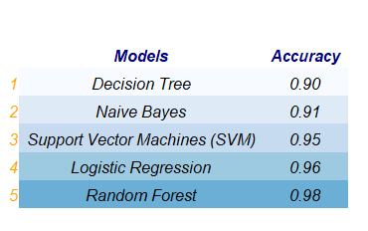
Other Models
Naive Bayes
Need less training data and model training time
Good if features are independent
Prediction accuracy: 0.91
Logistic Regression
Creating categorical predictors may have led to the inferiority of this model
Explain relationship between dependent binary variable and independent variables
Prediction accuracy: 0.96

Slide 16
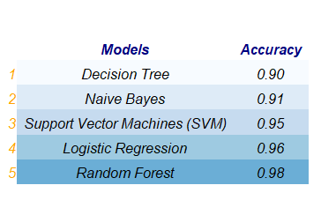
Other Models
Support Vector Machine (SVM)
Capable of both classification and regression
Uses kernel trick to transform small input features into
a much larger ones
Prediction accuracy: 0.95
Decision Tree
Perform feature selection and variable screening
Easy to interpret
Performance unaffected by non-linear relationship between parameters
Prediction accuracy: 0.90

Slide 17
Limitations
Additional knowledge of the predictors would optimize our data cleaning methods and in turn bring more accurate results
Knowledge of other learning techniques and their advantages may have improved accuracy
Parameter tuning would improve existing techniques

Slide 18
Acknowledgements
We express deepest appreciation to Dr. Akram for arming us with machine learning techniques needed to complete this competition to the best of our ability!
We thank Dean De Cock for compiling a dataset that is an excellent alternative to the Boston housing data

